Slide 1
FLOYD WARSHALL
ALL PAIR SHORTEST PATH

Slide 2
Introduction
All Pair Shortest Path: It aims to compute the shortest path from each vertex to every other nodes
The Floyd–Warshall algorithm (also known as Floyd's algorithm, the Roy–Warshall algorithm, the Roy–Floyd algorithm, or the WFI algorithm) is an algorithm for finding shortest paths in a weighted graph with positive or negative edge weights (but with no negative cycles).A single execution of the algorithm will find the lengths (summed weights) of shortest paths between all pairs of vertices.
Time complexity of the Floyd-Warshall algorithm is O(n^3).

Slide 3
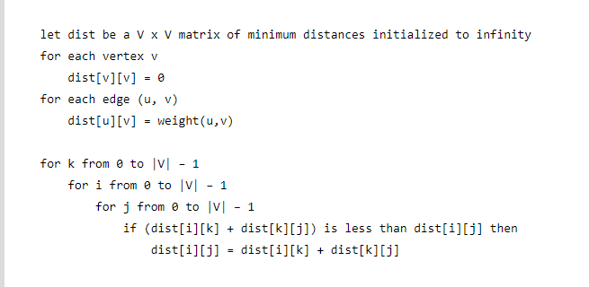

Slide 4
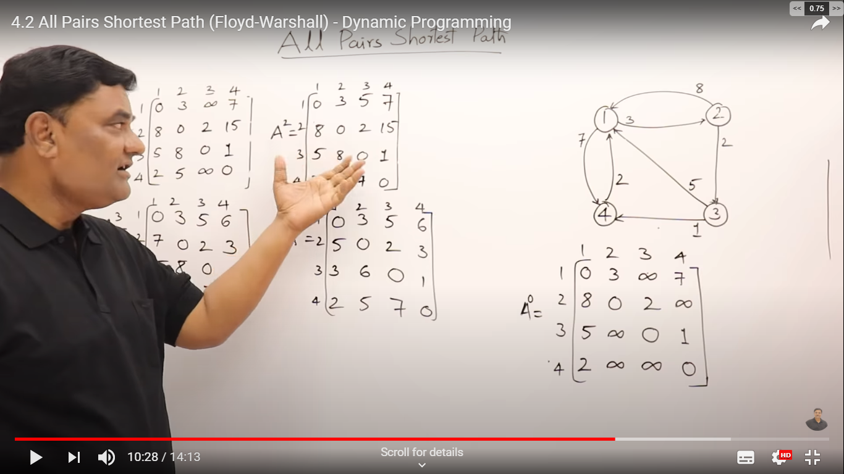
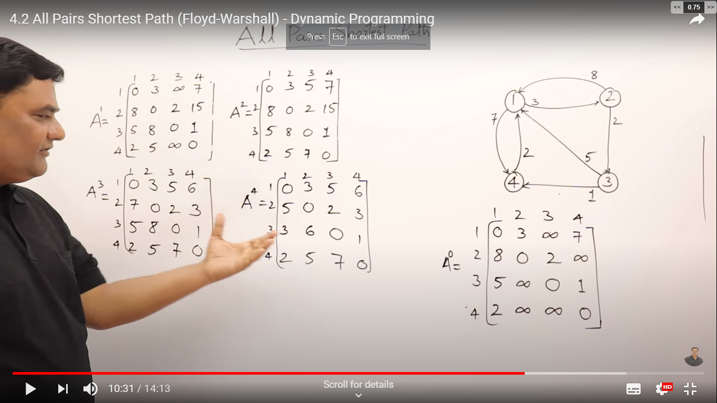
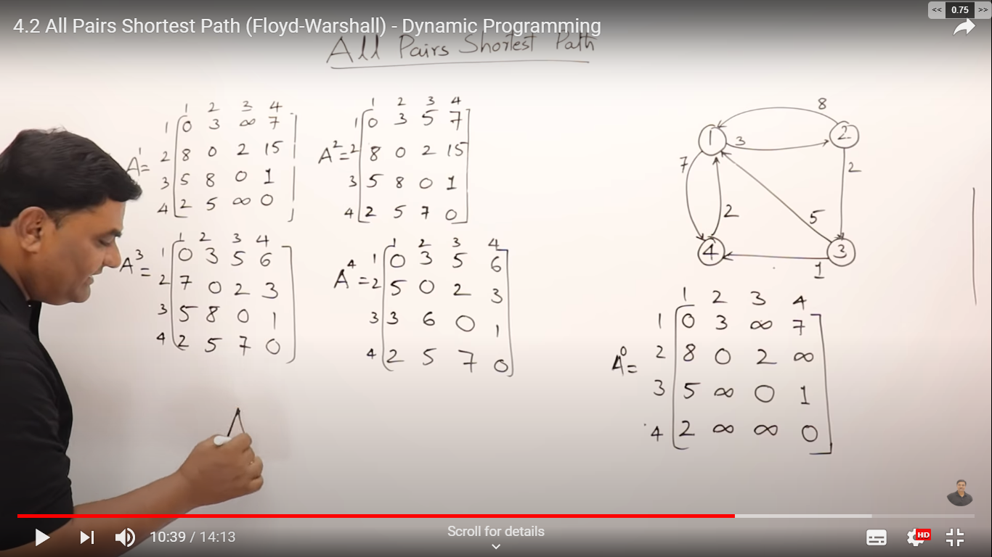

Slide 5
COMPLEXITY
We have to apply this algorithm n times, each time choosing a different as the source.
So the total computation time is n× 0(n2) = 0(n3)
This time complexity is same for best , average and worst case.

Slide 6
APPLICATIONS
Fast computation of path finder networks.
Optimal routing.
All pair shortest path.
Detecting negative-weight cycles in graph.

Slide 7
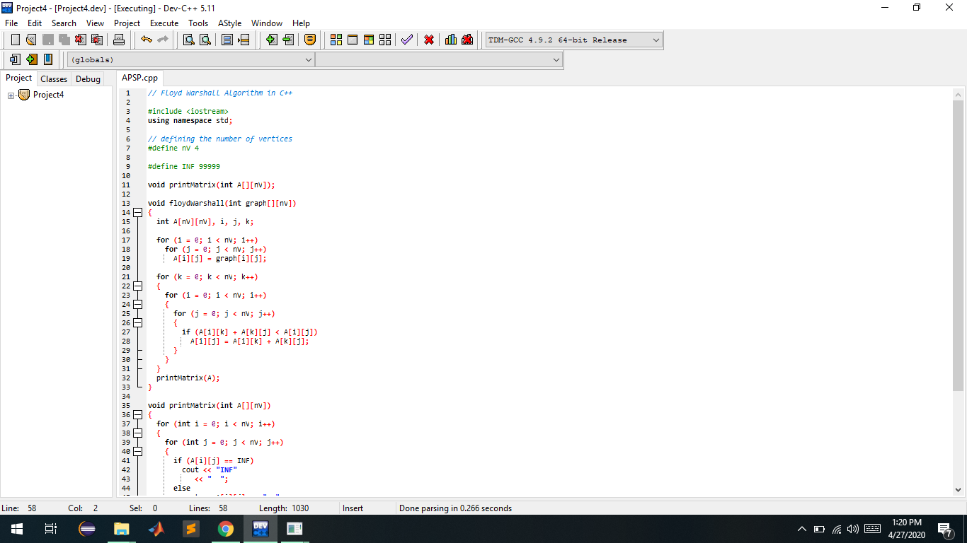
CODE-

Slide 8
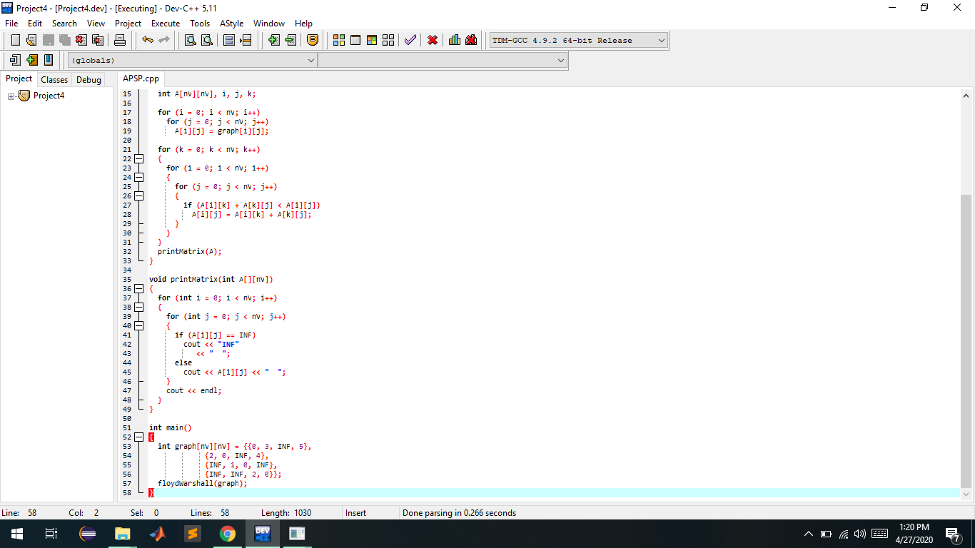

Slide 9
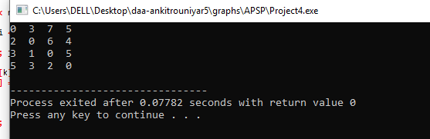
OUTPUT-

